Slide 1
Exploring São Paulo Neighbourhoods Venues
Paulo Cardoso - 2019/06/15

Slide 2
Introduction
The work is a capstone project for the Coursera course IBM Data Science Professional Certificate Specialization. The objective of this first part is to present a description of the problem and also point out with data will be used on the development of de project.

Slide 3
Problem Statement
It's possible replicate parts of the analysis performed during the course with São Paulo Data?
How can performed a grouping the neighborhoods and find out top 10 venues corresponding to that neighborhood in Sao Paulo, SP - Brazil?

Slide 4
Problem Description
Grouped by neighborhood exploring the venues around creating a top 10 venues by neighborhood in São Paulo. This kind of analysis can lead to possibility of identification of new opportunities for businesses, identification of the saturation of business segments in the neighborhood and also possibility to better understand the citie with its characteristics based on distribution of the venues.

Slide 5
Target Audience
Payment industry, this segment could take advantage of an analysis like to that to better position their self on the market, knowing where their product could have a better acceptance.
Investors thinking on open a new business in town, this kind of person could benefit from this analysis to rule out segment of business in tow due saturation of the kind of business on the neighborhood.
Social Science researchers curious with the behaviour and distribution of venues in the city.

Slide 6
Sucess Critteria
The success criteria of the project will be a good presentation of which are the top 10 kind of venue by neighborhood and some recommendation regarding which are the worst business segments to be opened on some neighborhoods.

Slide 7
Data
On this project was used data originated from three different sources, the first dataset gathered was the brazilian postal code dataset, the next one was data retrieved from the geocoder ArcGIS APIs/Python Library and the third and last source Foursquare API data. It’s important to say that the data gathered from the APIs was used to enrich the original postal code dataset.
Postal code: http://cep.la/CEP-dados-2018-UTF8.zip
Geocoder ArcGIS: https://developers.arcgis.com/python/guide/
Foursquare: https://developer.foursquare.com/docs/api

Slide 8
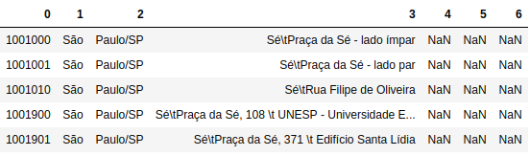
Data Cleansing
The original postal code data gathered on http://cep.la/CEP-dados-2018-UTF8.zip as several problems as for example:
Name of the city separated on more than one column
State abbreviation combined with second column of the city name
Neighborhood name and Street name concatenated
Three empty columns

Slide 9
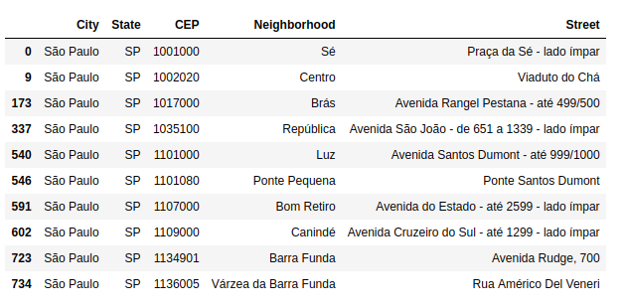
Data Cleansing
To mitigate this issue and enable analyses continuation a data cleansing must be applied, techniques of string handling, and dataframe entanglements were utilized on this cleansing. In order to demonstrate the result of cleansing process below is presented the cleaned dataset.

Slide 10
Methodology
Aquire Postal Code data from Brazilian cities, clean the data, perform data explorationg, plot basic statistics to describe the data and present metrics, plot maps to present the data gathered, perform feature engineering, clusterization using K-Means, demonstrate results.

Slide 11
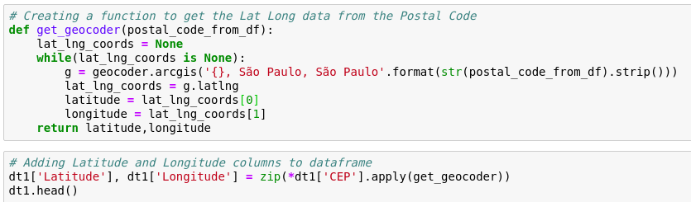
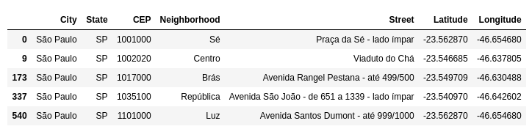
Data Exploration - Part 1
The first step of the data exploration was performed the enrichment of the postal code data with geolocation information, on another words latitude and longitude was added to the original cleaned data in order o enrich it. Below is presented the process of data enrichment by the creation of a function, the execution of the function and result dataset.

Slide 12
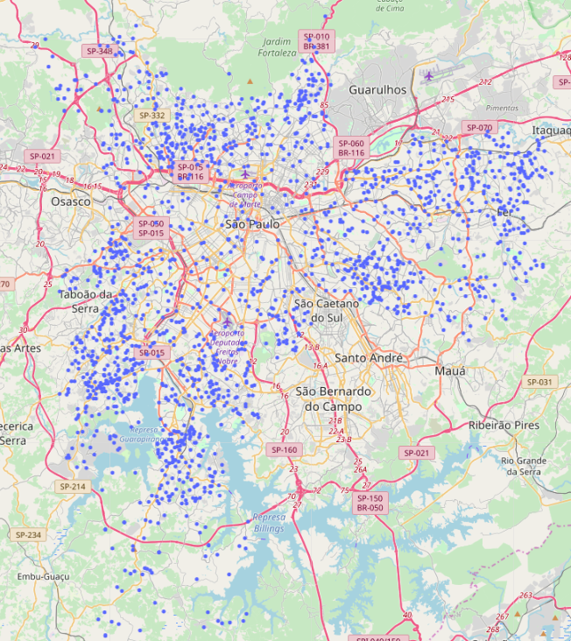
Data Exploration - Part 1

Slide 13
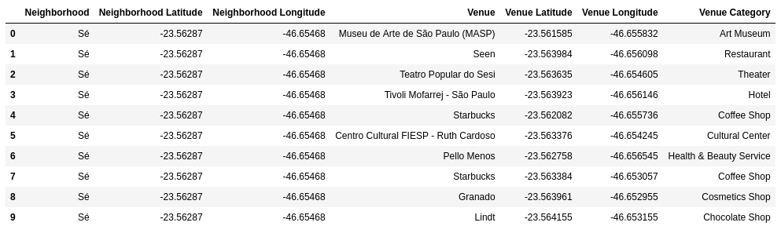
Data Exploration - Part 2
The second step of the data exploration is very similar to the first one, it also aimed into enrich the original data. But this turn the data source utilized was the Foursquare API, to do that, it was created a function responsible for based on a input of the neighbourhood name, latitude and longitude performed a API call to retrieve the foursquare data. The result of put all this API response data into a dataframe can be observed below.

Slide 14
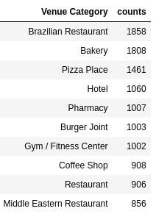
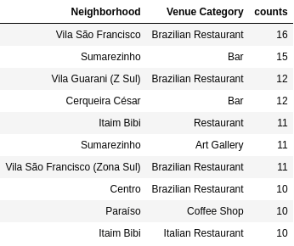
Data Presentation
Top 10 Venues Categories
Top 10 Venues Categories in the neighborhoods

Slide 15
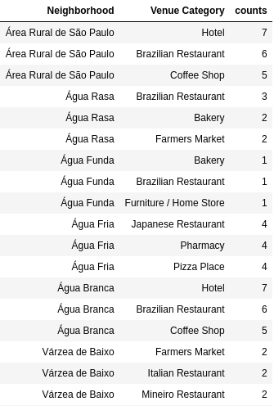
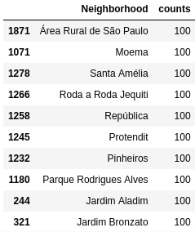
Data Presentation
Top 3 Venues Categories by neighborhoods
Top 10 neighborhoods with more venues
Obs.: Due Foursquare API restriction, the maximum number of venues by neighborhood is 100

Slide 16
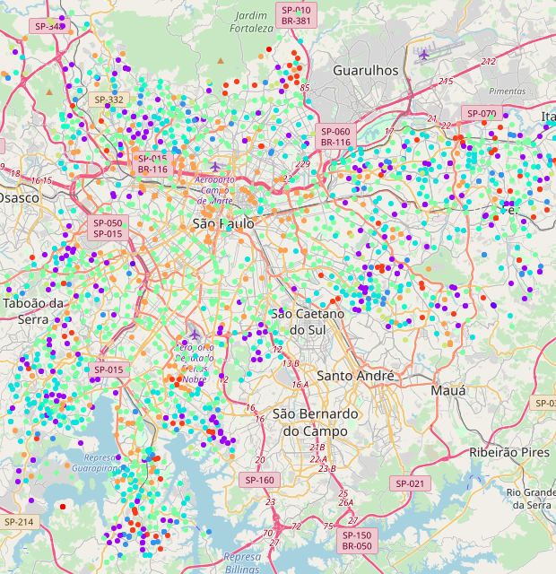
Results
The result of this project can be understood as the clustering of the neighborhoods based on the similarity of the top 10 venues. To define the ideal amount of clusters several tests were performed with several different number of clusters as for example 3, 4, 5, 6, 7, 8, 9 and 10 clusters. Below is the plot that represents the distribution of the ten clusters:

Slide 17
Results
Cluster # | Amount of Neighborhoods
Cluster 0 | 238
Cluster 1 | 5
Cluster 2 | 83
Cluster 3 | 327
Cluster 4 | 95
Cluster 5 | 681
Cluster 6 | 65
Cluster 7 | 278
Cluster 8 | 96
Cluster 9 | 4
Regarding the Cluster size, below is presented the amount of clusters created in this analysis and also the amount of neighborhoods on each of this clusters.

Slide 18
Discussion
As presented on de previous section, the map plot and the frequency of neighborhoods by cluster. Adding to that, when looing at this data and the data of the data exploration it’s possible to extrapolate some recommendations having on mind the target audience mentioned at the begining of the work.

Slide 19
Recommendation
Payment industry: could use this data to improve market research amd target specific segments to getter a better penetration and capilarity in terms os sales. Also, another point it would be knowing the neighborhood distribution on the clusters would be easyer to target campaings to stimulate sales.
Investors: São Paulo is one of best gastronomical city in the world, several excelent restaurants. I would recommend open a nich restaurant on neighborhoods of cluster 4 because its already a place where the best restaurants are located.
Social Science researchers: the cluster distribution in the map denote a clear income differance, as rings the clusters are opening letting clear the differences on social class.

Slide 20
Conclusion
To conclude is important to point out that all problem statements and descrtiption were achived and provided insightful response and recommendations about which would be the best actions depending on certain scenarios. So in a whole this analysis was succesful and achived its objectives.

